Slide 1
Web Technologies Mini Project
Game On
Gauri Menon PES1UG19CS163
Guhan K PES1UG19CS71
Harshita Vidapanakal PES1UG19CS185

Slide 2
Introduction
This web application is an online game interface. It allows the user to choose between two games - Tic Tac Toe and Quiz. The main technologies used are NodeJS, ReactJS and MongoDB. The application consists of the following functionalities:
Initially, a login/signup page is displayed. Any user is required to login in before playing(New users - sign up before login)
Subsequently, the new page is loaded where the user gets to choose one of the two games.
There are two paths from here, one for each game. Selection of the game redirects them to another new page.
Score is displayed after every game. A track of their previous scores is also maintained and displayed on request.

Slide 3
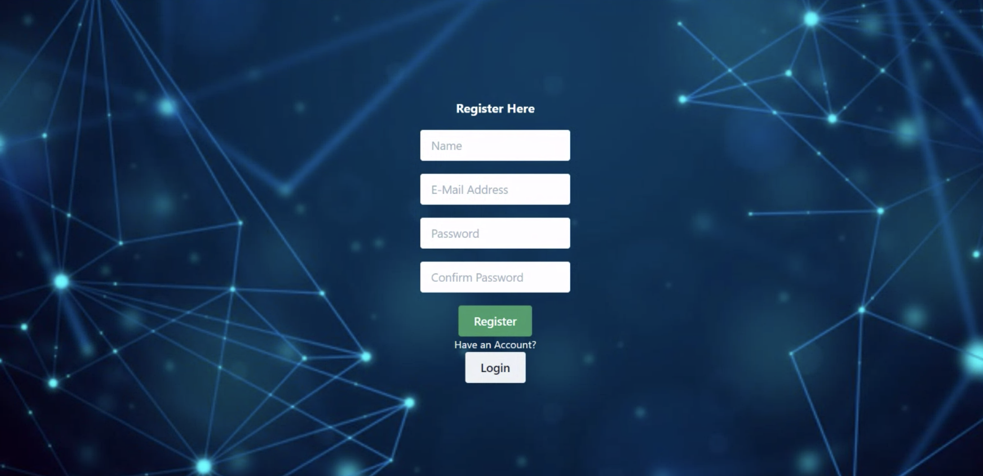
Register Page
Allows a new user to register

Slide 4
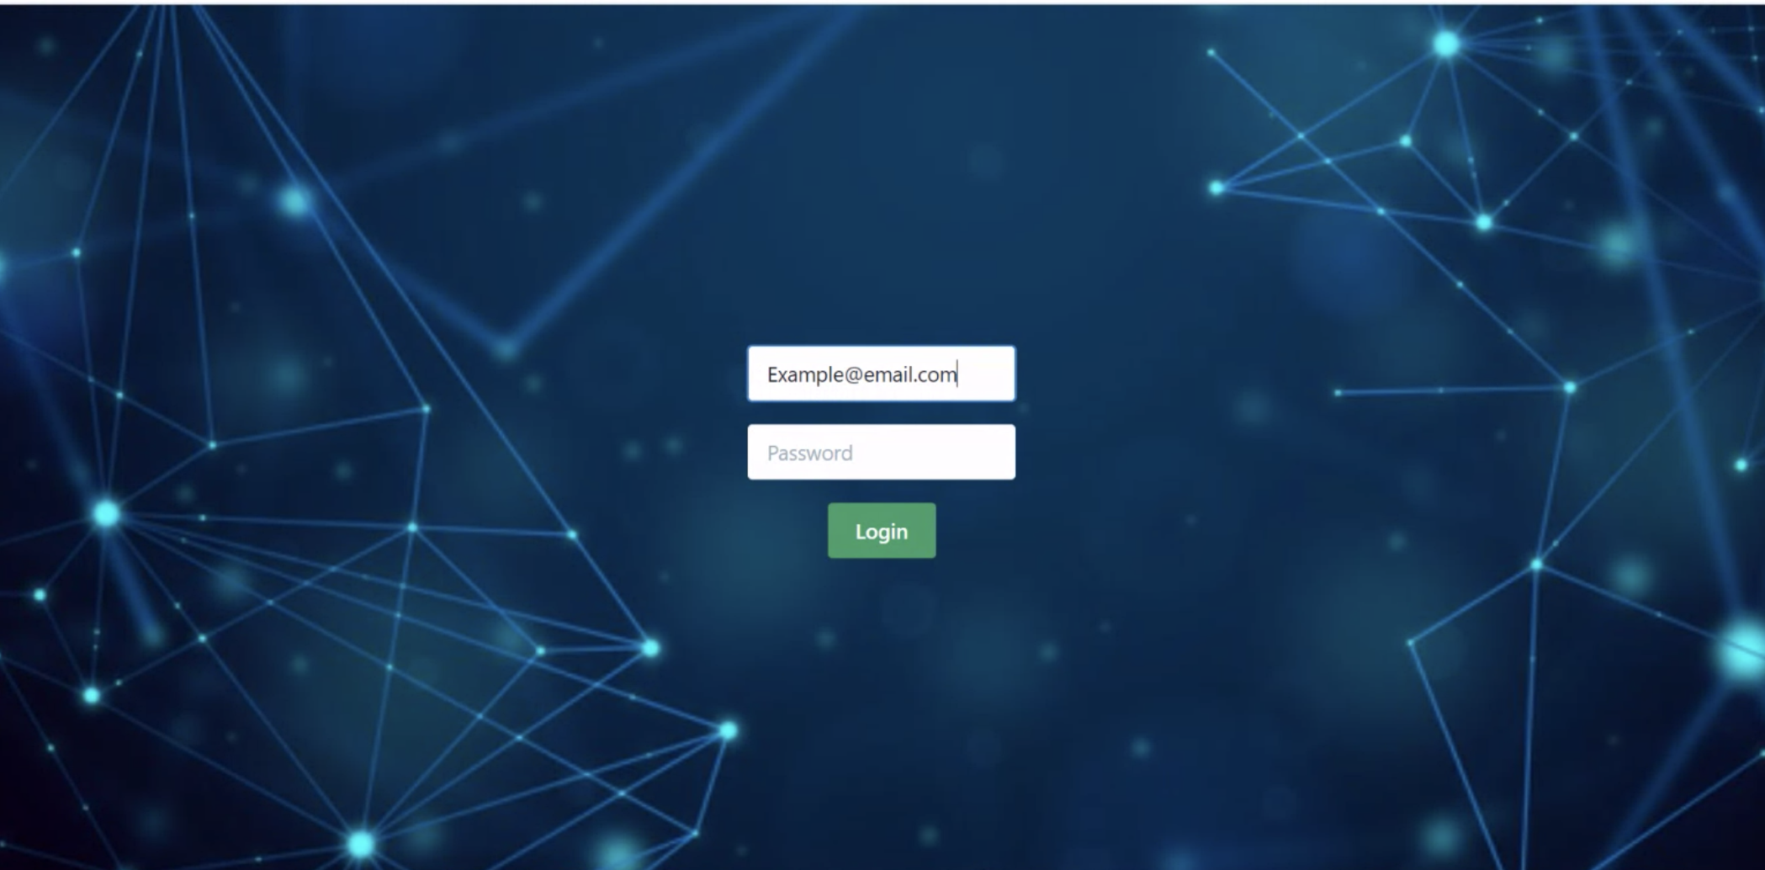
Login Page
Accepts user email, password and authenticates if the user is a valid , giving appropriate error when required

Slide 5
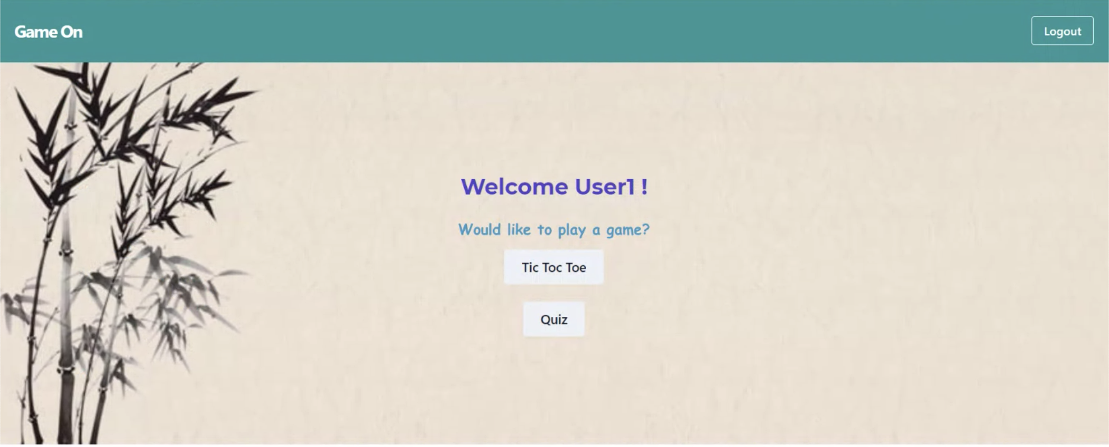
Home Page
Redirects user to appropriate game pages or allow the user to logout

Slide 6
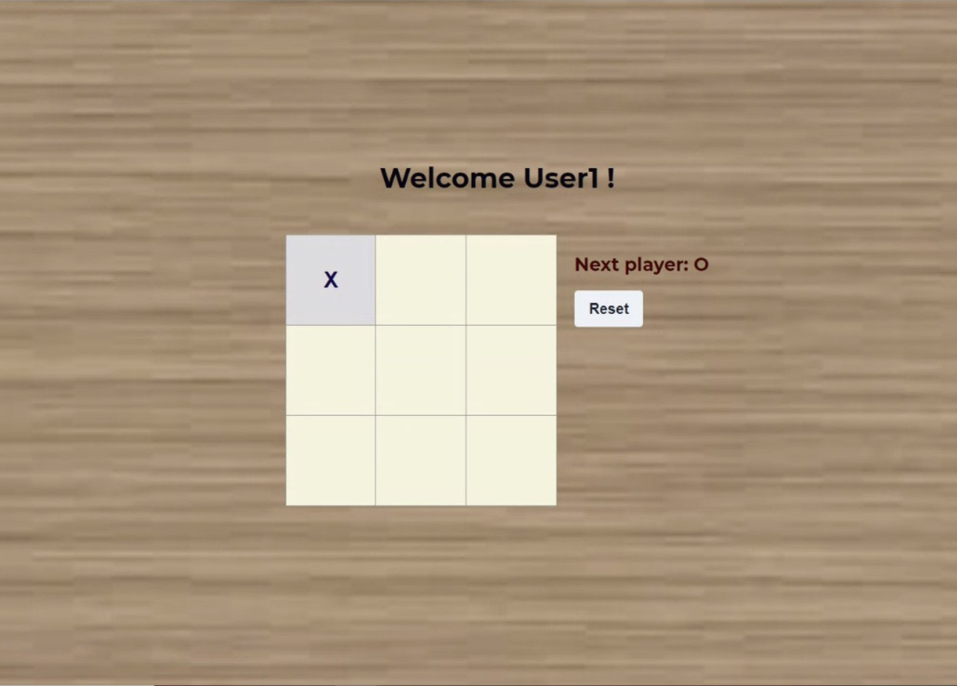
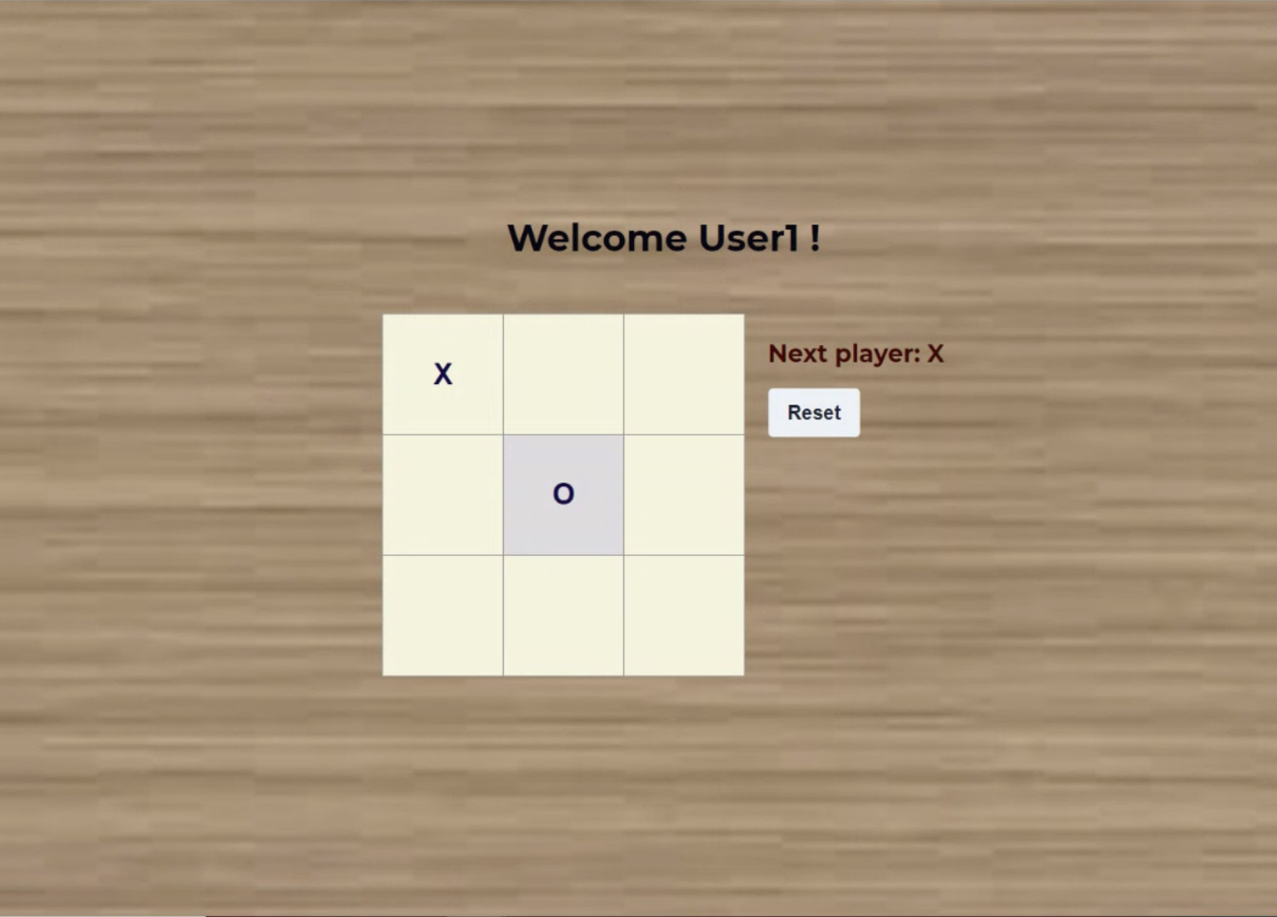
Tic-Tac-Toe

Slide 7
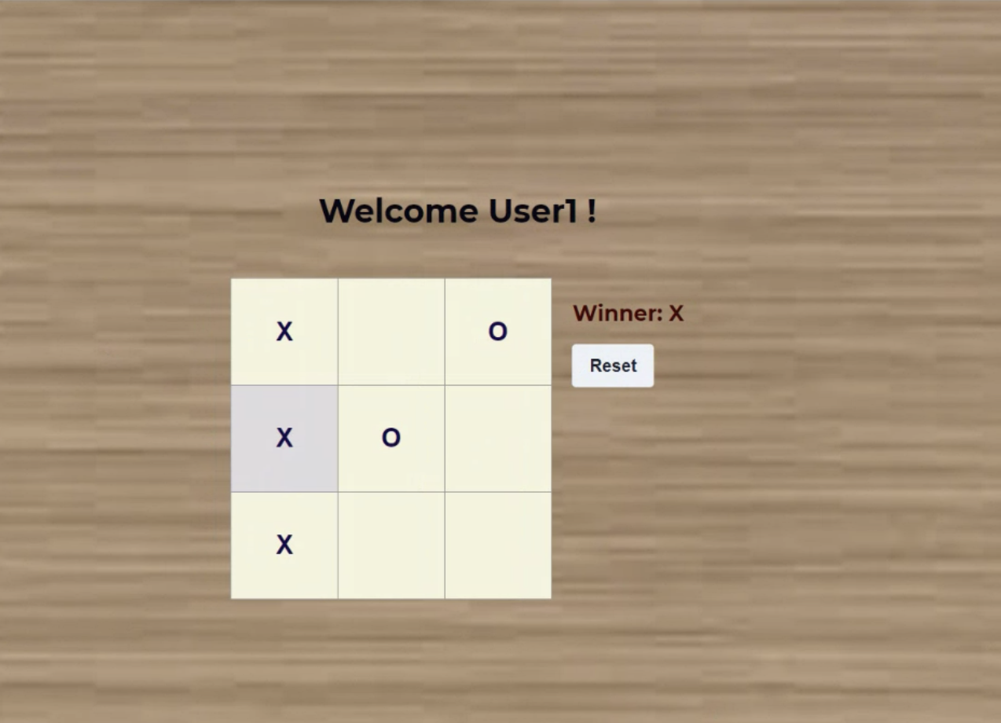
Tic-Tac-Toe Result
Case 1: User Wins

Slide 8
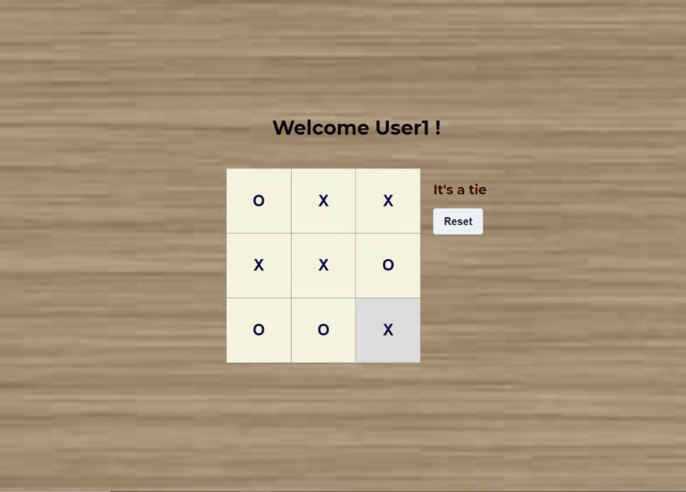
Tic-Tac-Toe Result
Case 2: Match Ties

Slide 9
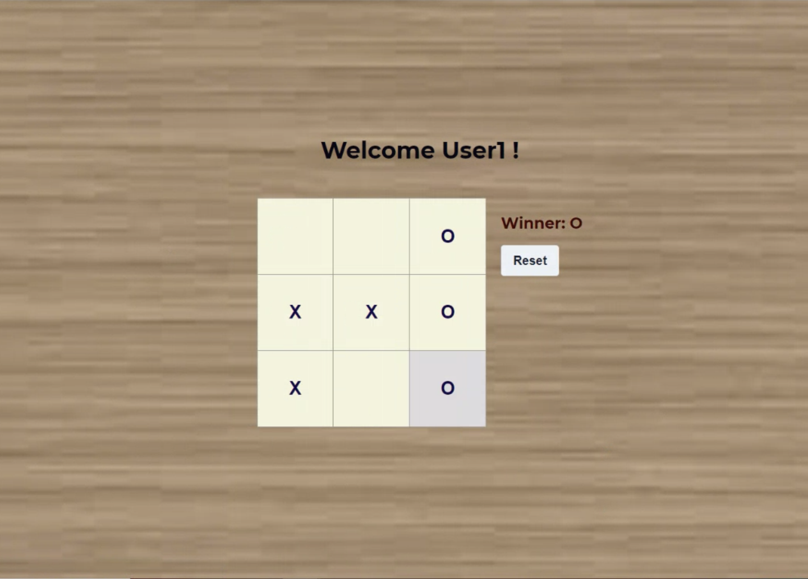
Tic-Tac-Toe Result
Case 3: User Loses

Slide 10
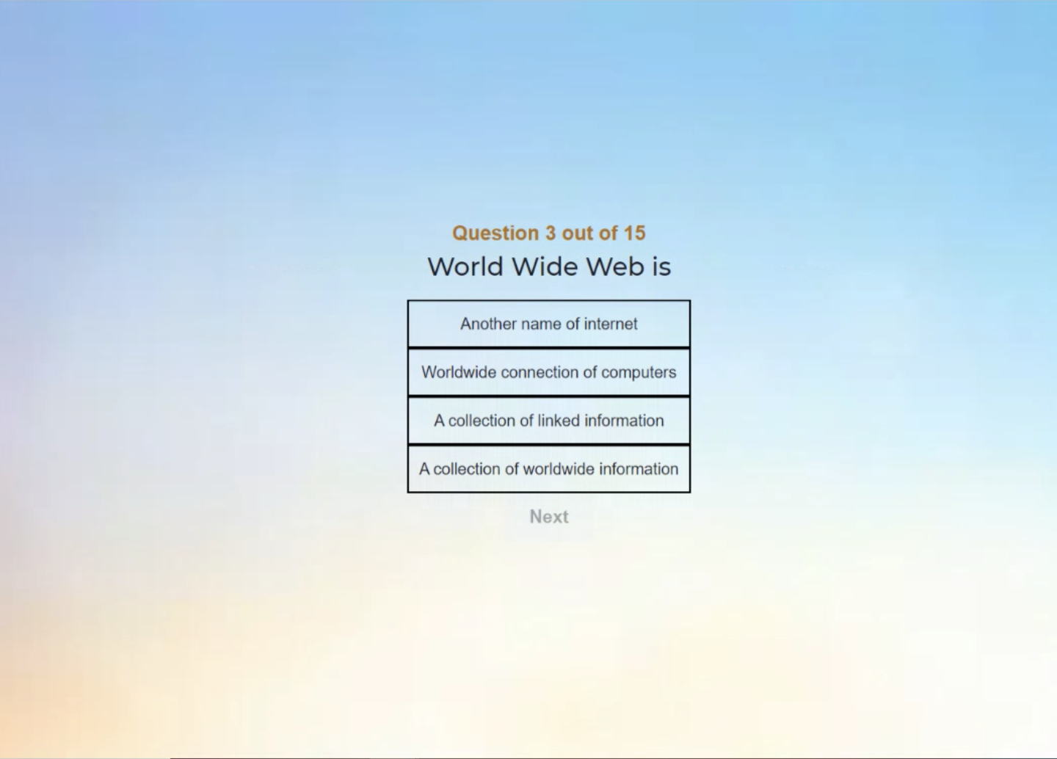
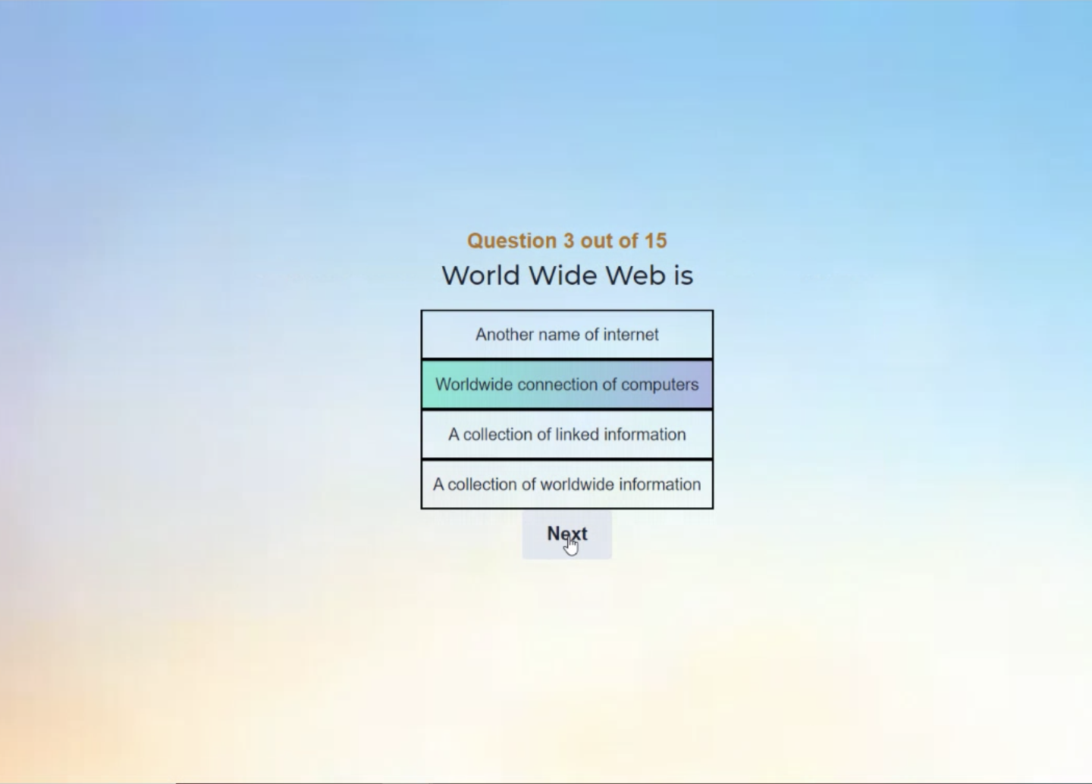
Quiz
A total of 15 questions are present. Attempting a question will enable the user to move on to the next question.

Slide 11
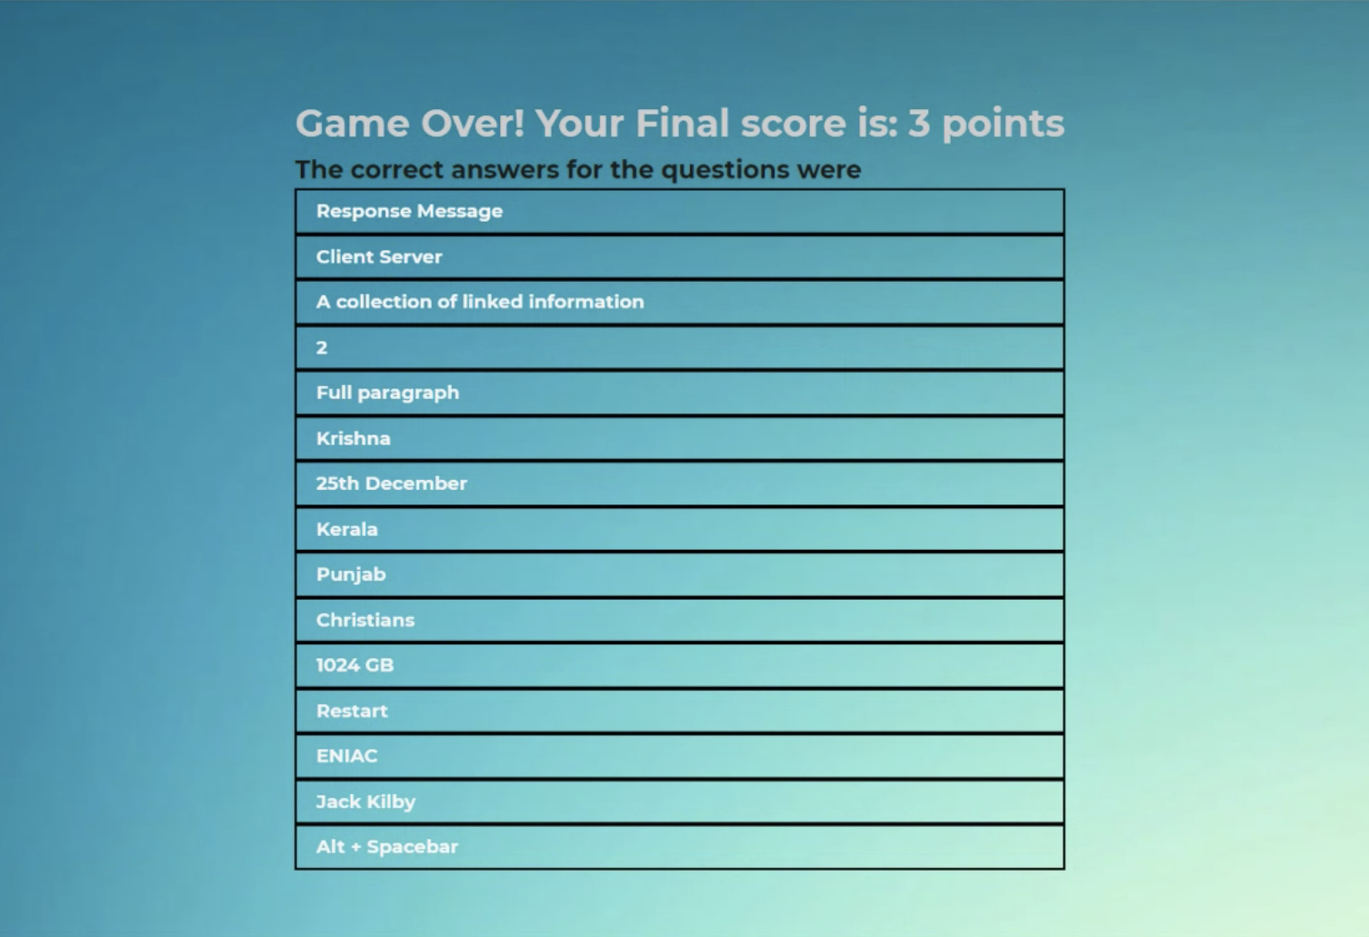
Quiz Result

